Slide 1
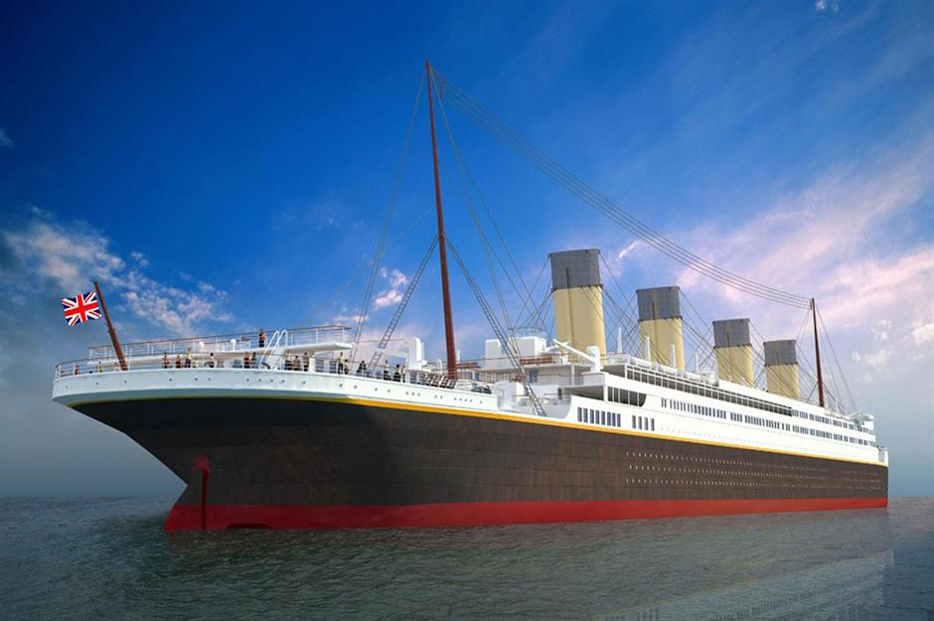

Titanic Survival Predictor
Presented by Tidiane

Slide 2
Our goal: Build a model to help predict whether a passenger survived or not
Data Processing
Import
Imputation
Encoding
Exploratory Data Analysis
Survivors
Ages
Class
Gender
Reporting
Insights
Machine Learning Models
Heuristic
Logistic regression
K Nearest neighbours

Slide 3
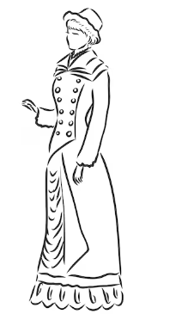

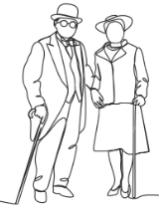


RMS Titanic embarked on its maiden journey on April 15 1912 with 2224 on board
Our train sample: 891
314 female
74% survived
Median fare £23
139 on board
50% survived
577 male
20% survived
Median fare £10.5
22 seniors
Oldest were 80 and 63 years
26% survived

Slide 4
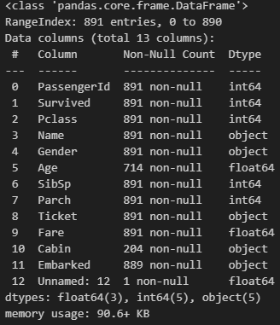
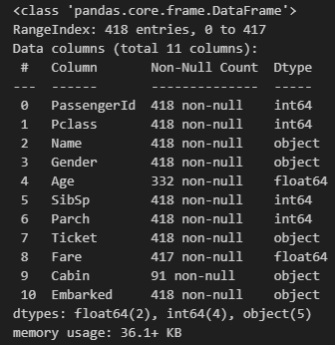
Data Processing: imputation, encoding, insert columns, drop columns
Train Test
Encoding Imputation Zero value imputation inserted col deleted col

Slide 5

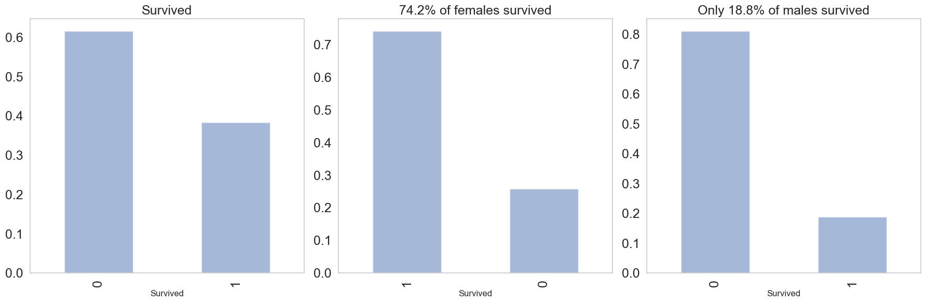
Exploratory Data Analysis: Survived

Slide 6
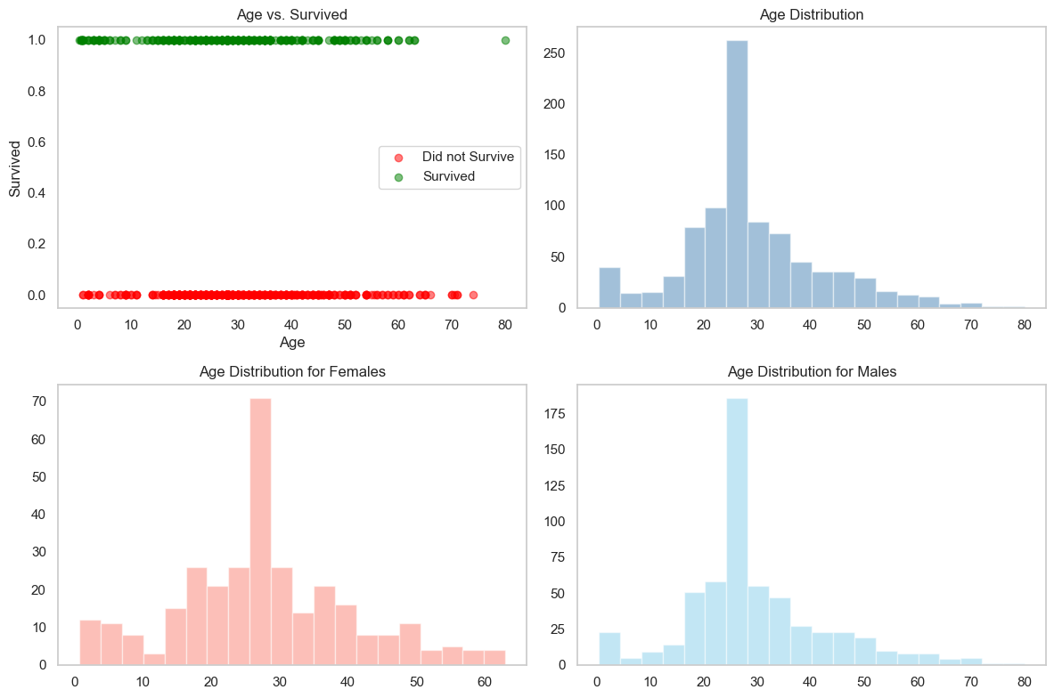
Exploratory Data Analysis: Age

Slide 7
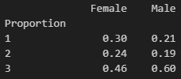
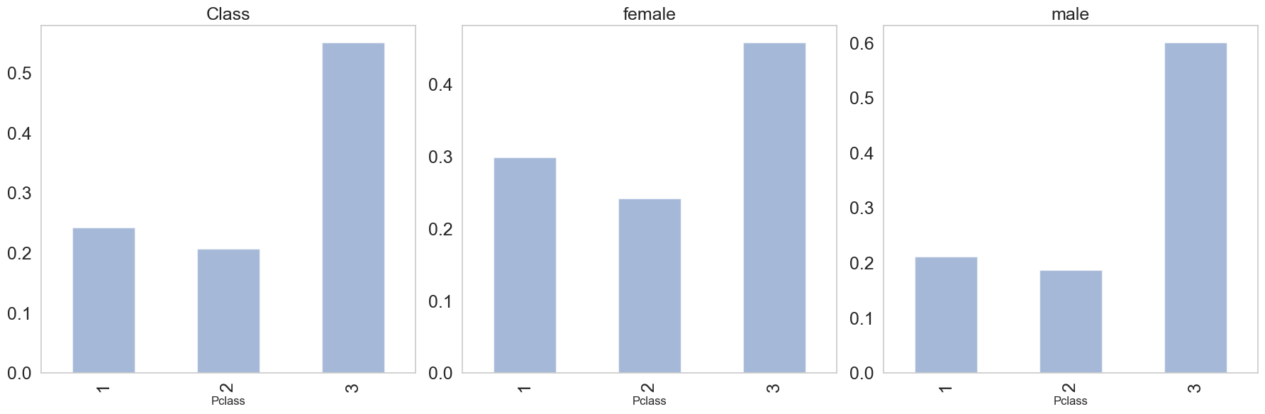
Exploratory Data Analysis: Passenger Class

Slide 8
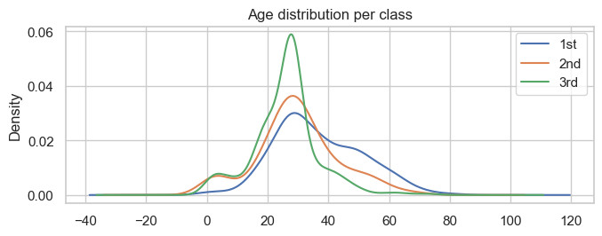
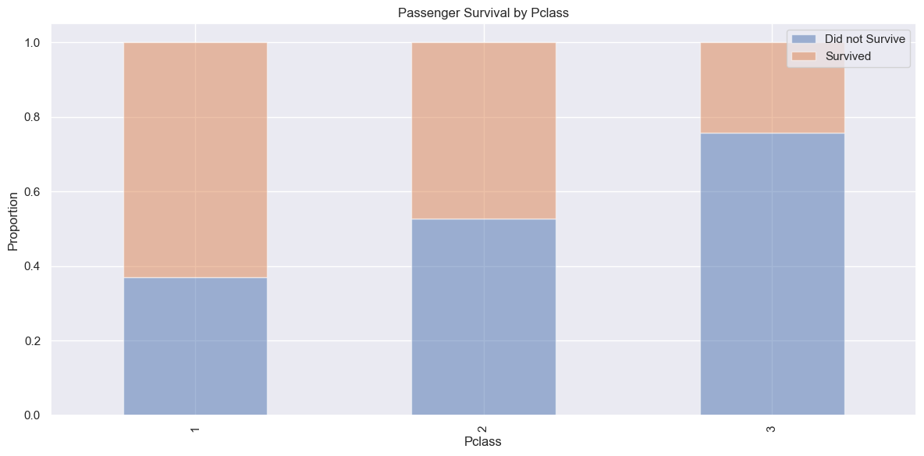
Exploratory Data Analysis: ~62% of Class 1 passengers survived vs. ~23% for Class 3

Slide 9
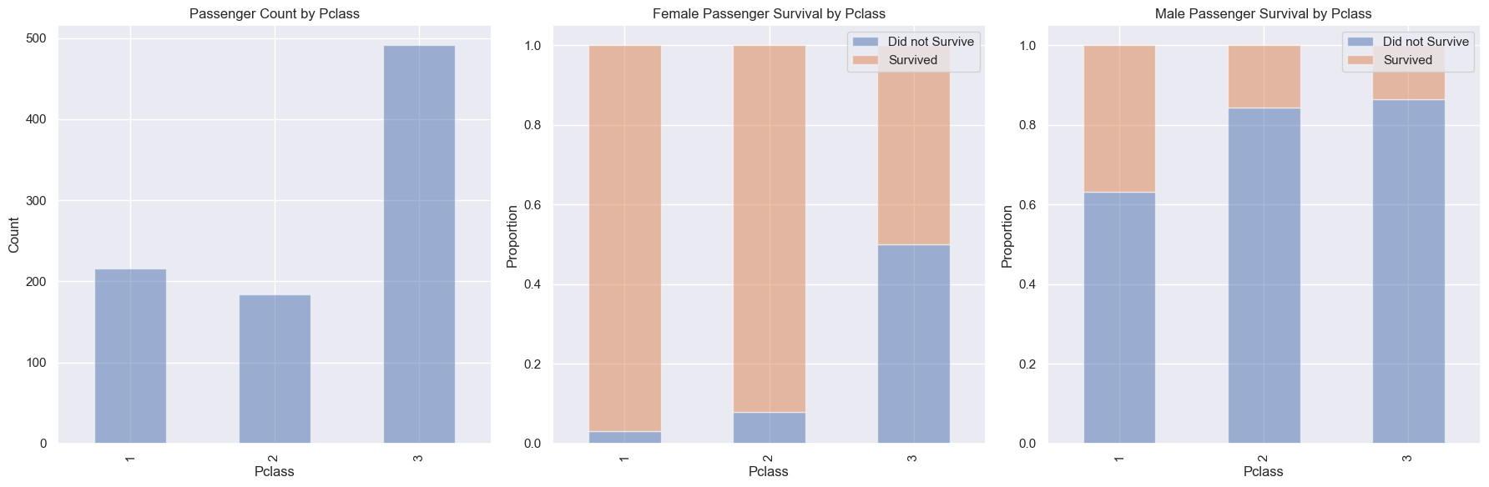
Exploratory Data Analysis: Gender, a decisive factor

Slide 10

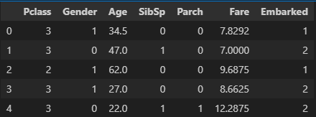
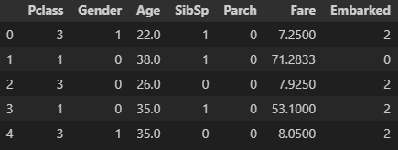
Machine Learning Model: “Women and children first”
Binary outcome (Survived / Did not Survived) Classification models
Train Model
Test Model

Slide 11
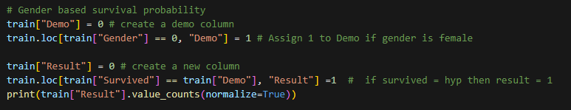
Heuristic model: “Women and children first”

Slide 12
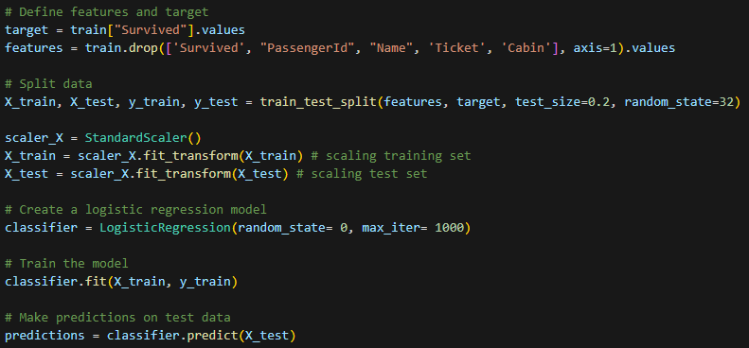
Logistic regression

Slide 13
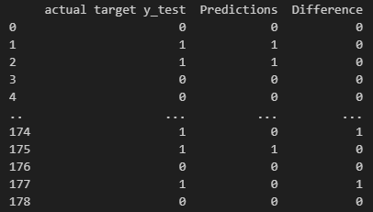

Logistic regression: Test and performance metrics: An accuracy of ~79.3%

Slide 14
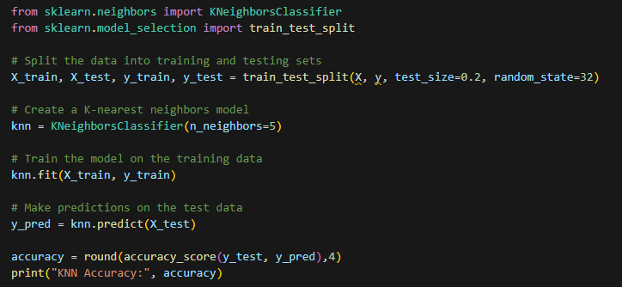
K-Nearest Neighbour

Slide 15
Insights
“Women and children first”
Accuracy rates across models close to female survival probability (78%)
The wealth factor was crucial

Slide 16
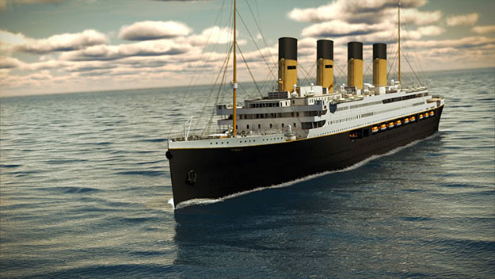
Thank you
Thank you

